Slide 1
Lesson objective
Title: Representing data
Aim:
Be able to create stem and leaf diagrams, dot plots and graphs
Plan:
Review: dot plots and, stem and leaf
Different methods to display data

Slide 2

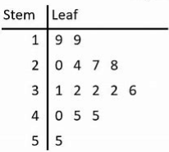
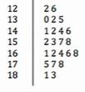
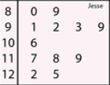
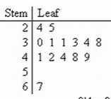
Stem and Leaf Diagrams
The stem contains the first part of each number
The leaves contain the last digit of each number
The numbers represented in this Stem and Leaf Diagram are:
19
19
20
24
27
28
31
32
32
32
36
Read out the numbers represented in these Stem and Leaf Diagrams with me
40
45
45
55

Slide 3
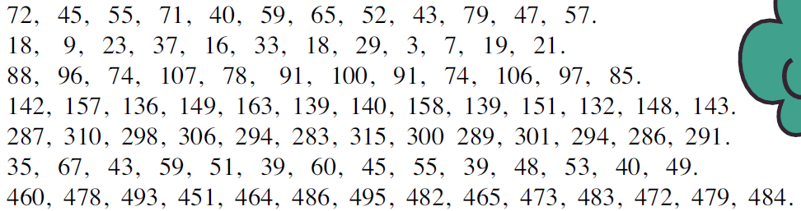
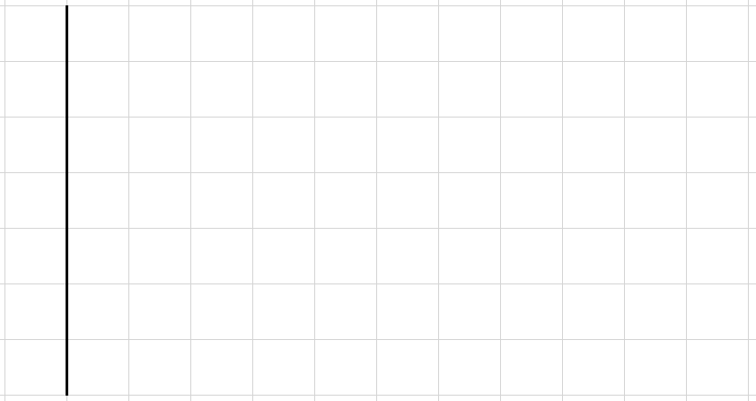

Putting data into a Stem and Leaf Diagram
Put the data in order
Set up the stem
Fill in the leaves
Write the Key
40, 43, 45, 47, 52, 55, 57, 59, 65, 71, 72, 79
4
5
6
7
0
3
5
7
2
5
7
9
5
Key:
1
2
9
means 52

Slide 4

Putting data into a Stem and Leaf Diagram
Put the data in order
Set up the stem (whiteboards)
Fill in the leaves (whiteboards)
Write the Key
3, 7, 9, 16, 18, 18, 19, 21, 23, 29, 33, 37
0
1
2
3
3
7
9
6
8
8
9
1
3
9
Key:
3
7
means 21

Slide 5
Putting data into a Dot Plot
Draw scale to fit the highest and lowest numbers
Write the numbers on the lines
Fill in dots on the grid
4, 7, 5, 5, 6, 4, 7, 8, 2, 5, 6, 6, 5, 5, 7, 5, 7, 5, 3, 6
2 3 4 5 6 7 8

Slide 6
Putting data into a Dot Plot
Draw scale to fit the highest and lowest numbers
Write the numbers on the lines
Fill in dots on the grid
20, 22, 21, 21, 23, 22, 20, 20, 21, 21, 21, 22, 20, 21, 20, 21
On your whiteboards
20 21 22 23

Slide 7
Putting data into a Dot Plot
Draw scale to fit the highest and lowest numbers
Write the numbers on the lines
Fill in dots on the grid
7, 9, 11, 12, 13, 15, 12, 10, 9, 12, 11, 9, 11, 10, 11
On your whiteboards
7 8 9 10 11 12 13 14 15

Slide 8
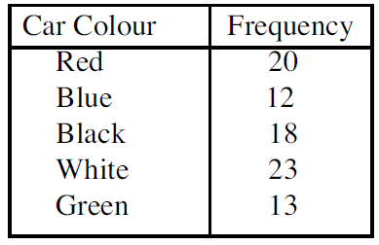

Drawing a Column Graph
28
Car Colours
26
With categories the columns can’t touch
Set up $y$-axis scale to extend past the highest frequency
Set up categories on $x$-axis
Draw in the columns one at a time
Write title and labels
24
22
20
18
16
14
12
10
8
Frequency
6
4
2
0
Red
Blue
Black
White
Green
Colour

Slide 9
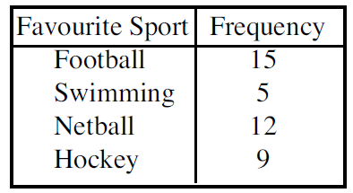
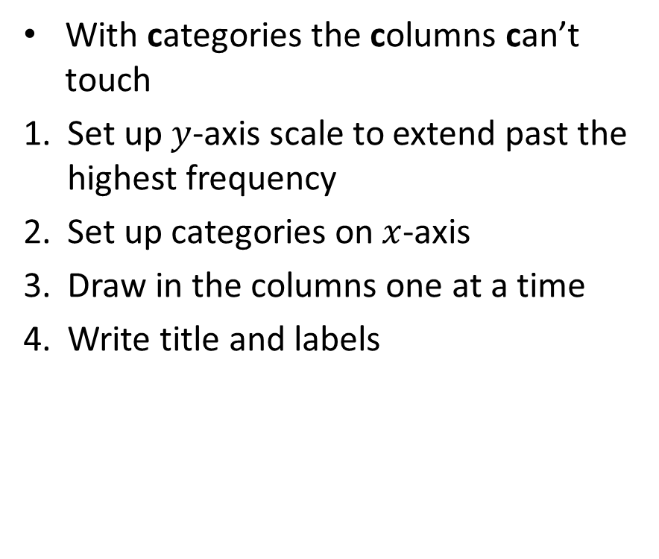
Drawing a Column Graph
With categories the columns can’t touch
Set up $y$-axis scale to extend past the highest frequency
Set up categories on $x$-axis
Draw in the columns one at a time
Write title and labels
20
Favourite Sport
18
16
14
12
10
8
Frequency
6
4
2
0
Football
Swimming
Netball
Hockey
Sport

Slide 10
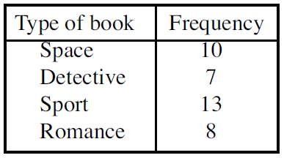
You do: Whiteboards
14
With categories the columns can’t touch
Set up $y$-axis scale to extend past the highest frequency
Set up categories on $x$-axis
Draw in the columns one at a time
Write title and labels
Type of Book
12
10
8
6
4
Frequency
2
0
Space
Detective
Sport
Romance
Type

Slide 11
Individual practice
Answer the questions in your exercise book.

